Slide 1
BPM and microservices

Slide 2

Hello!
I am Andrey Dolmatov
Is it possible to use BPM engine in a “microservices world”?
You can find me at:
Andrey.Dolmatov@south.rt.ru

Slide 3
1.
About microservices
Let’s start with a brief overview of microservices

Slide 4
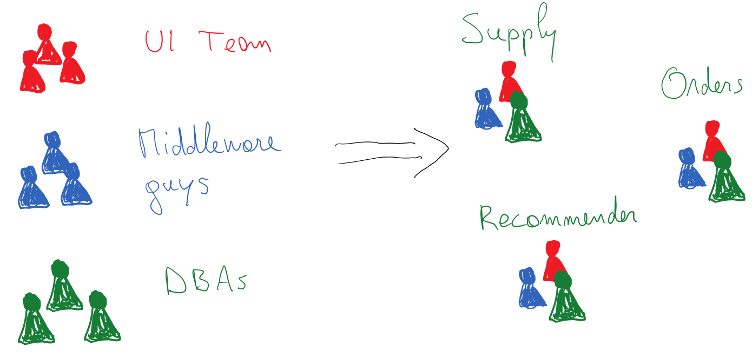
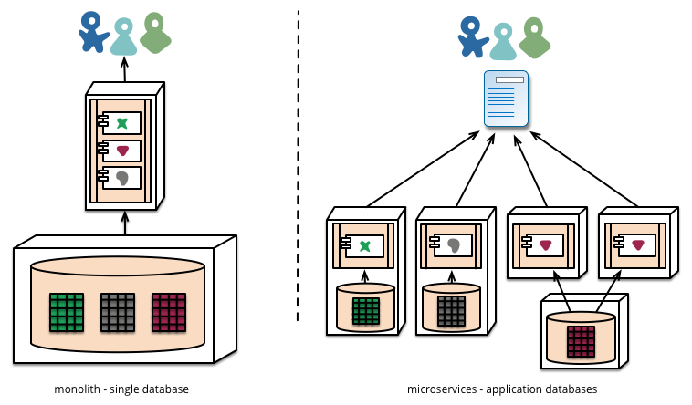
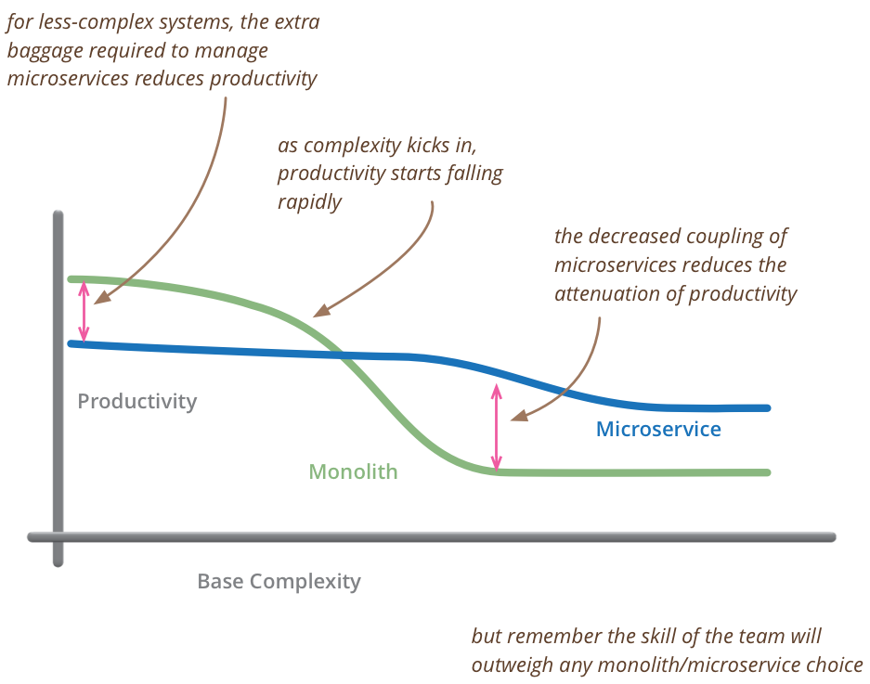
From monolith to microservices
Agility and productivity
Scalability
SOA = “build for reuse”,
microservices = “build for replacement”[1]

Slide 5
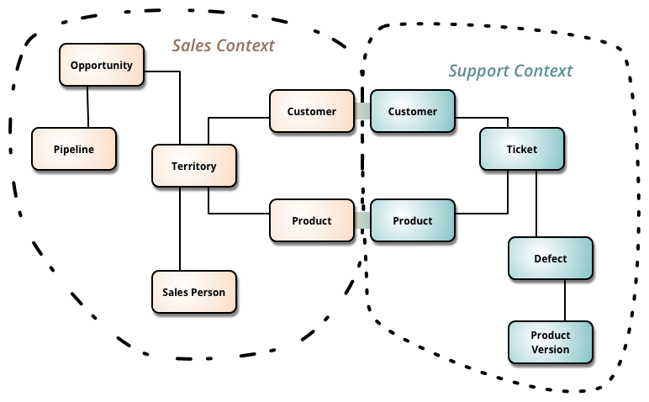
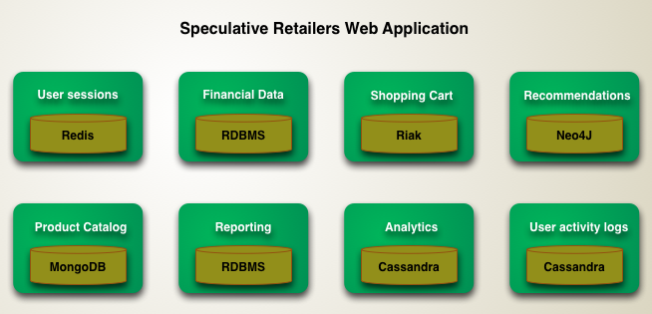
Microservices data management
BoundedContext [5]
PolyglotPersistence [6]

Slide 6
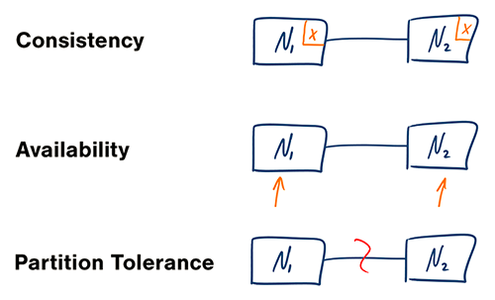
Distributed and asynchronous
Starbucks Does Not Use Two-Phase Commit [7]
CAP theorem [13]
“Of three properties of shared-data systems (Consistency, Availability and tolerance to network Partitions) only two can be achieved at any given moment in time.” Eric Brewer
Consistency - A read is guaranteed to return the most recent write for a given client.
Availability - A non-failing node will return a reasonable response within a reasonable amount of time (no error or timeout).
Partition Tolerance - The system will continue to function when network partitions occur.

Slide 7
2.
Orchestration or Choreography?
Smart endpoints and dumb pipes [8]

Slide 8
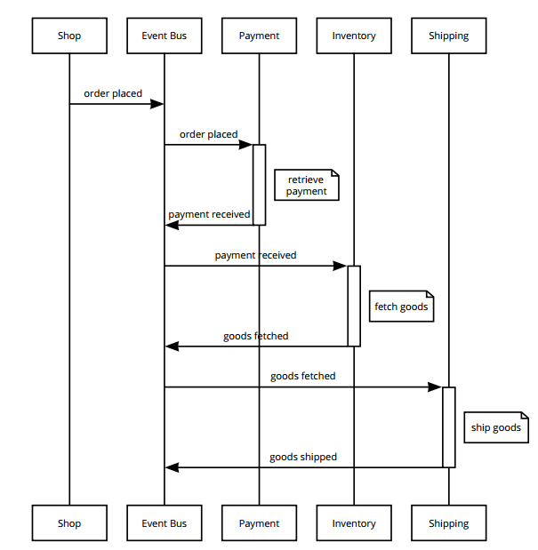
Orchestrator [11]
ESB (SOA)
Single microservice
BPM engine

Slide 9
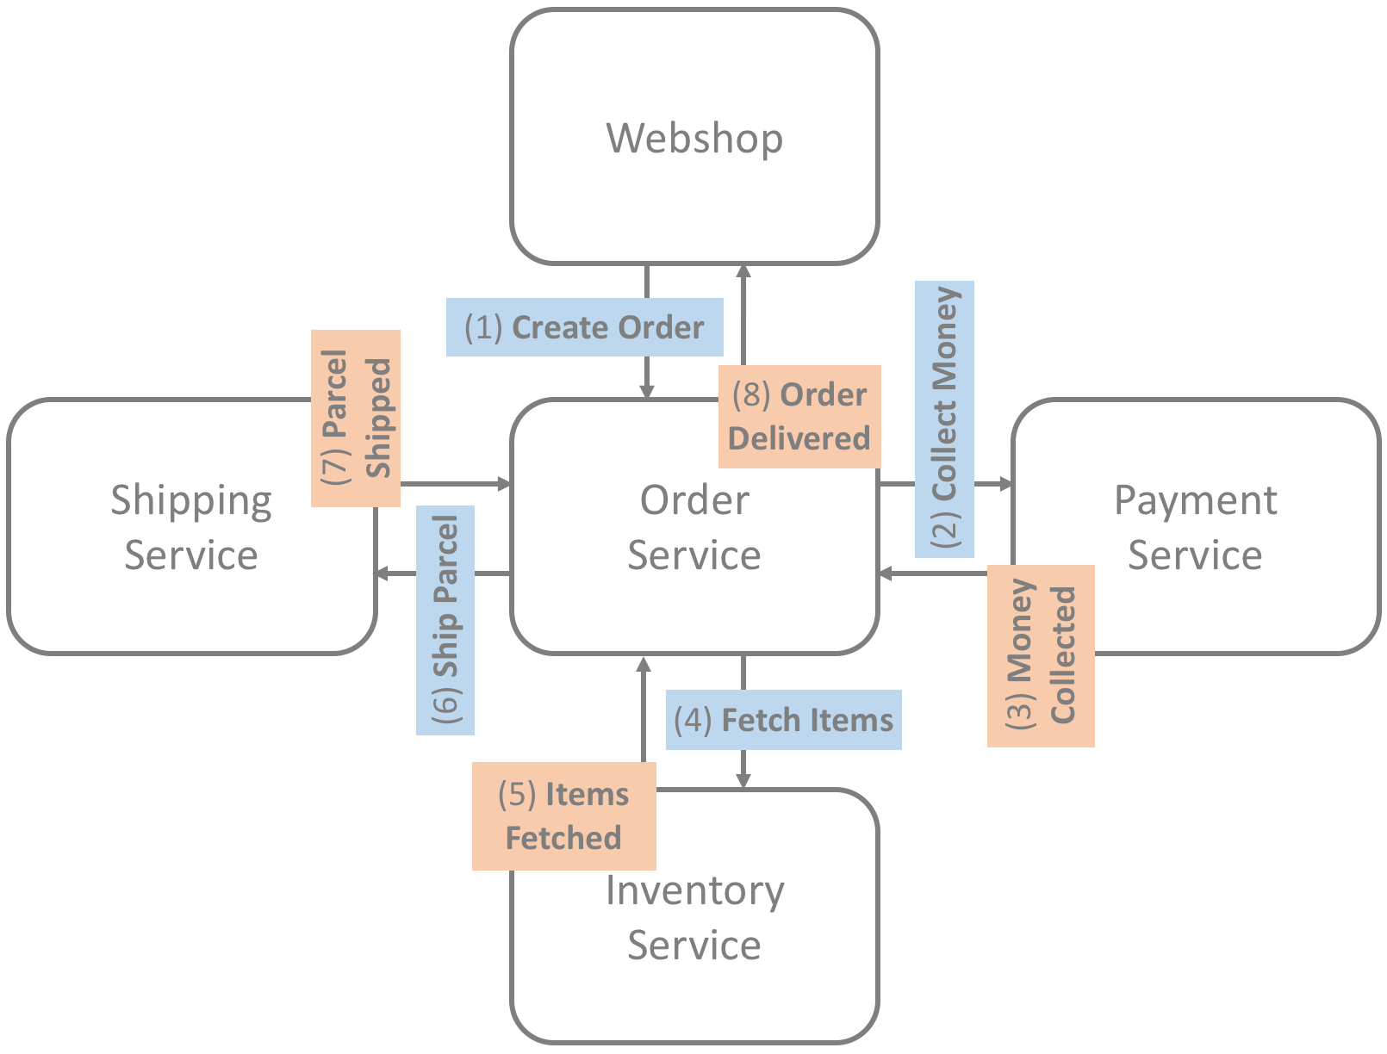
Orchestrator [11]
ESB (SOA)
Single microservice
BPM engine

Slide 10
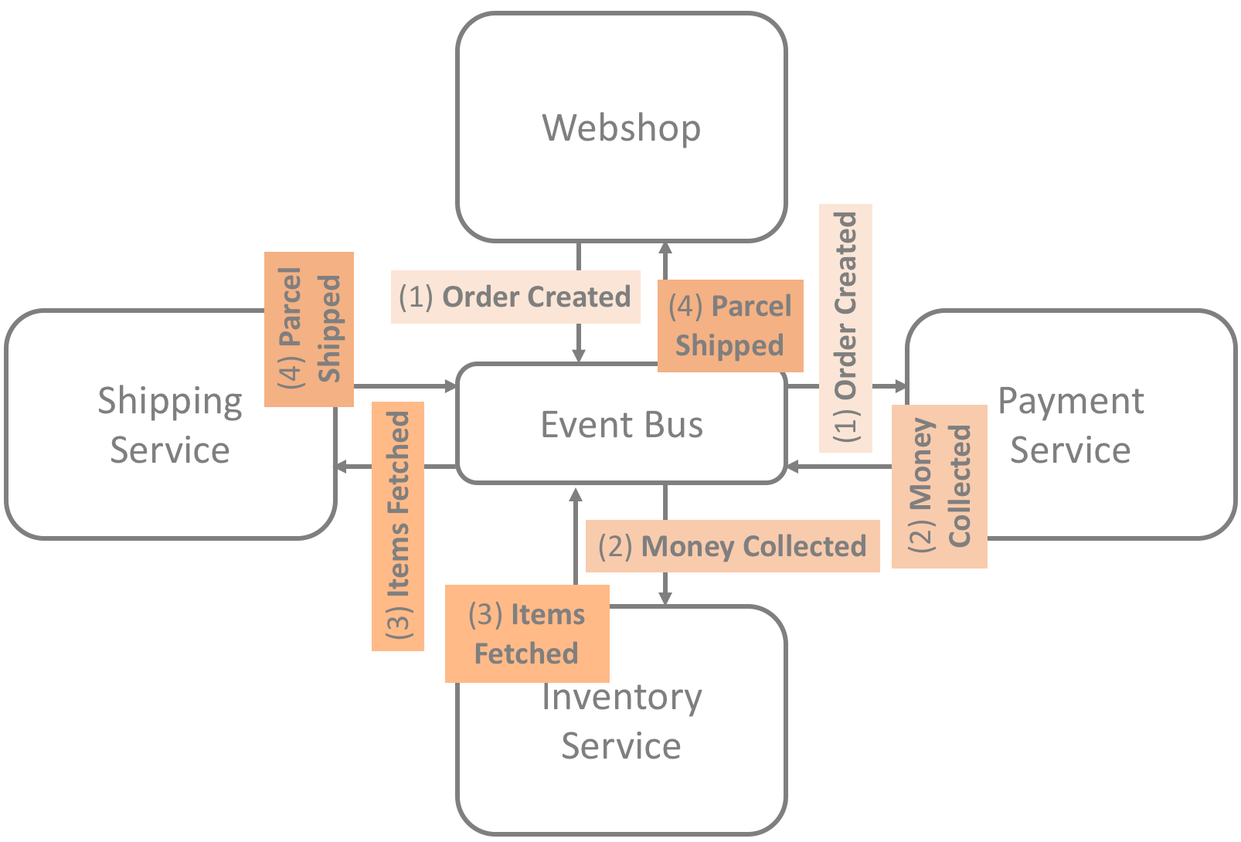
Choreography [11]
Event command transformation [12]
Asynchronous communication

Slide 11
3.
Flow
Communication between microservices

Slide 12
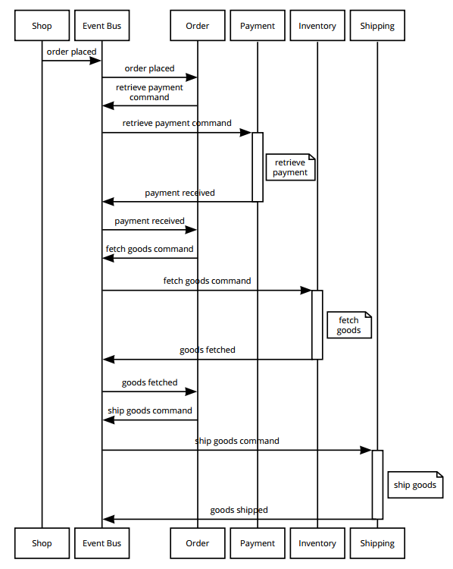
Communication between microservices [2]
Complex flow
Choreography
Flow hardcoded inside microservices
Debug
Control

Slide 13


Netflix Conductor: A microservices orchestrator
With peer to peer task choreography, we found it was harder to scale with growing business needs and complexities [10]

Slide 14
4.
BPM engine
Orchestrator or not?

Slide 15
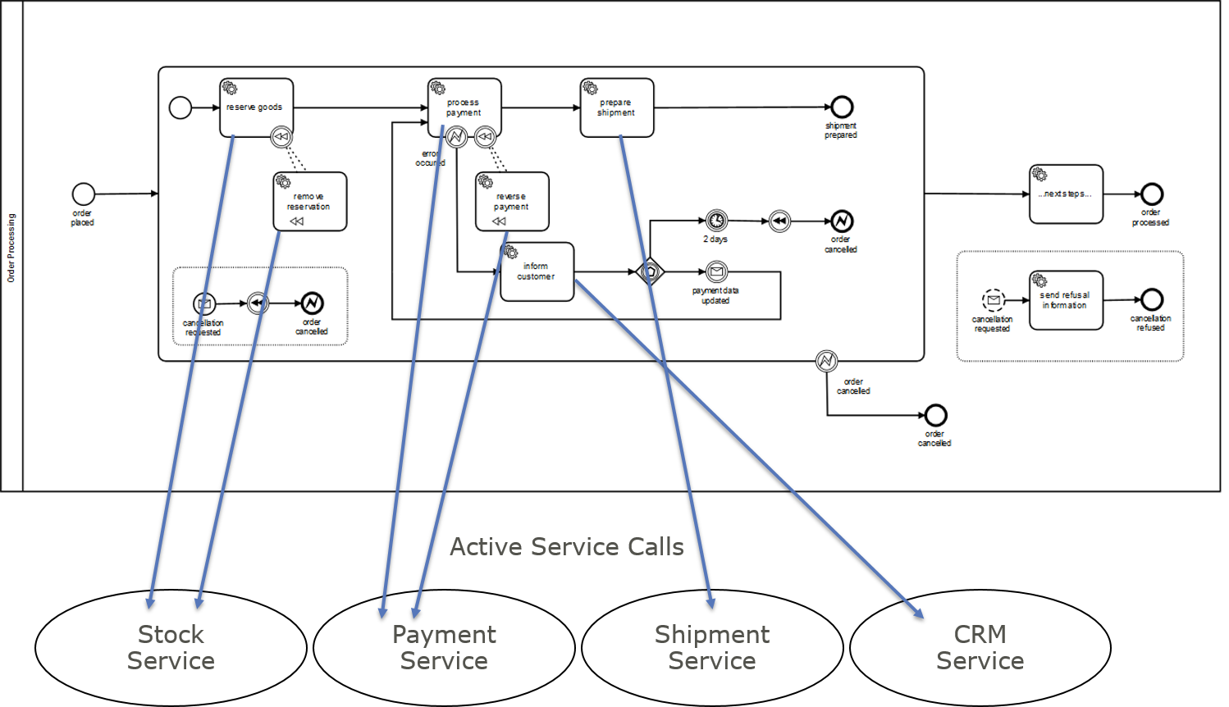
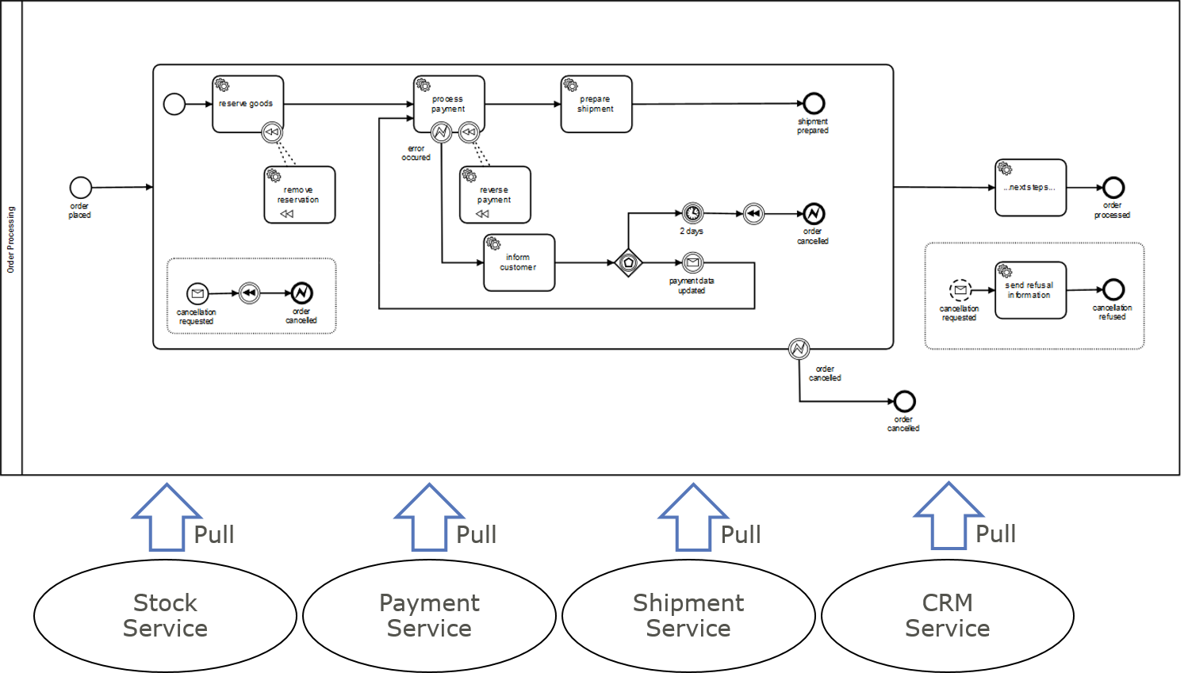
Pull vs. Push: External Tasks Pattern [14]
Workers pull tasks and execute
GET /engine-rest/external-task/foo?maxTasks=3&maxWait=4000
Process Engine does not need network connection to worker.
Availability of Process Engine and Worker is decoupled (temporal) – if a Worker is not available the engine just waits until a service task is finished somewhere in future.
Scalability: You can easily add new workers which execute jobs.
Technologic independence: The worker can be written in any technology you like as long as they can ask for jobs at the process engine (typically via http -> REST).

Slide 16
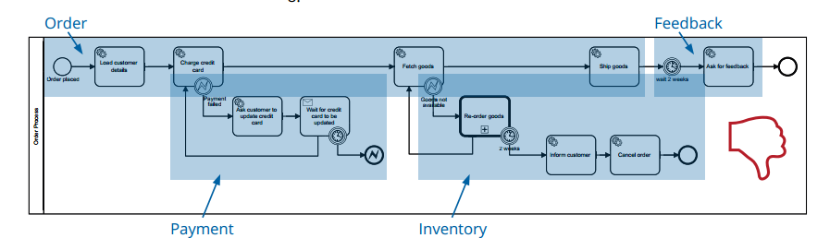
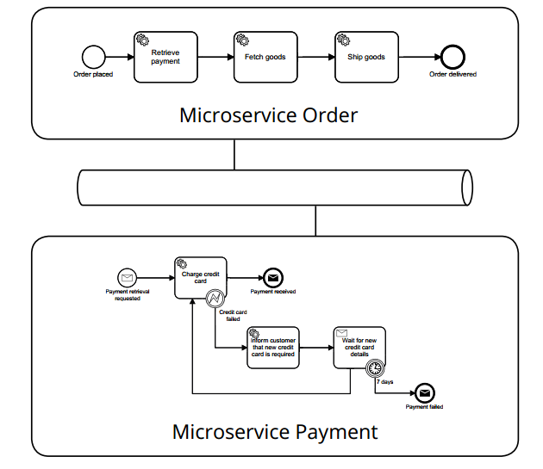
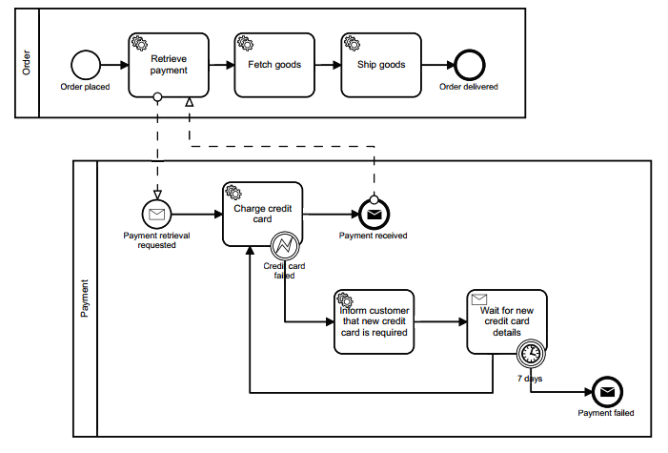
Distributed Ownership of the end-to-end Process [2]

Slide 17
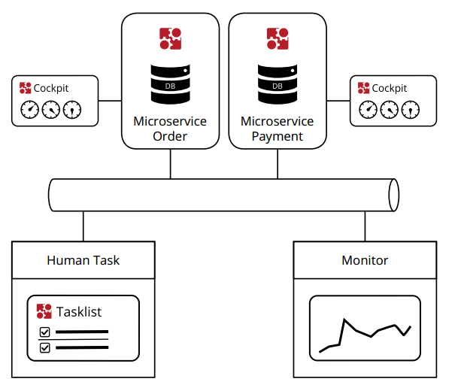
Lightweight and Embeddable Engine [2]
Run embedded in the microservice
Cloud ready

Slide 18
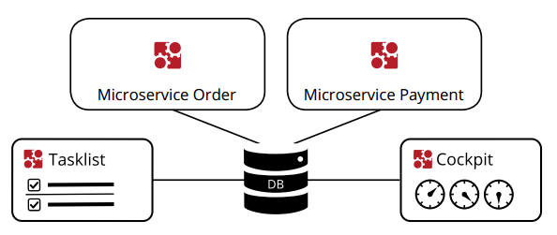
Alternative [2]
Shared database
Single task list
Single monitoring
Rolling upgrade of database (for example engine 7.4 works with database 7.6)

Slide 19
Links and literature
Camunda, BPM & Microservices, 2015 https://network.camunda.org/whitepaper/16
Camunda, Microservices and BPM, 2017 https://network.camunda.org/whitepaper/54
Redhat, Business process management in a "microservices world", 2016 https://developers.redhat.com/blog/2016/10/10/business-process-management-in-a-microservices-world/
Jan Kettenis, Are MicroServices the Death of BPM and Case Management?, 2017 http://kettenisblogs.blogspot.ru/2017/03/are-microservices-death-of-bpm-and-case.html
Martin Fowler, BoundedContext, 2014 https://martinfowler.com/bliki/BoundedContext.html
Martin Fowler, PolyglotPersistence, 2011 https://martinfowler.com/bliki/PolyglotPersistence.html
Gregor Hohpe, Starbucks Does Not Use Two-Phase Commit, 2004 http://www.enterpriseintegrationpatterns.com/ramblings/18_starbucks.html
Martin Fowler, Microservices, 2014 https://martinfowler.com/articles/microservices.html#DesignForFailure
Martin Fowler, TolerantReader, 2011 https://martinfowler.com/bliki/TolerantReader.html
Netflix, Netflix Conductor: A microservices orchestrator, 2017 https://medium.com/netflix-techblog/netflix-conductor-a-microservices-orchestrator-2e8d4771bf40
Martin Shimak, Orchestration or Choreography, 2017 http://plexiti.com/de/blog/2017/03/microservices-orchestration-or-choreography
Bernd Rücker, Event command transformation in microservice architectures and DDD, 2017 https://blog.bernd-ruecker.com/event-command-transformation-in-microservice-architectures-and-ddd-dd07d5eb9656
Robert Greiner, CAP Theorem: Revisited, 2014 http://robertgreiner.com/2014/08/cap-theorem-revisited/
Bernd Rücker, From Push to Pull – External Tasks in BPMN processes, 2015 http://www.bpm-guide.de/2015/04/10/from-push-to-pull-external-tasks-in-bpmn-processes/

Slide 20
Thanks!
Any questions?

